Slide 1
Capstone Project Cardiovascular risk prediction
By- Ayush Ambhore

Slide 2
Points for discussion
Problem Statement
Data summary
Exploratory Data Analaysis
Feature Engineering and Data Pre-processing
Correlation Heatmap
Evaluation Metrics after Model Building
Model Selection
Challenges Faced
Conclusion

Slide 3
Problem statement
The goal of this project is to develop a machine learning model that can accurately predict the 10-year risk of Coronary Heart Disease (CHD) based on various demographic, behavioral, and medical history features of patients. The dataset contains information on gender, age, smoking status, blood pressure medication, previous stroke history, hypertension, diabetes prevalence, and medical measurements such as cholesterol levels, blood pressure, BMI, heart rate, and glucose levels.

Slide 4
Data summary
Demographic:
Gender: Indicating the biological sex of the patient (categorical: "Male" or "Female").
Age: The patient's age, measured in years (continuous variable). Behavioral:
Smoking Status: Whether or not the patient is a current smoker (categorical: "Yes" or "No").
Average Cigarettes Per Day: The average number of cigarettes smoked per day by the patient (continuous variable).
Medical History:
Blood Pressure Medication: Whether or not the patient is currently taking blood pressure medication (categorical: "Yes" or "No").
Previous Stroke: Whether or not the patient has previously experienced a stroke (categorical: "Yes" or "No").
Hypertension Prevalence: Whether or not the patient has been diagnosed with hypertension (categorical: "Yes" or "No").
Diabetes Prevalence: Whether or not the patient has been diagnosed with diabetes (categorical: "Yes" or "No").
Current Medical Measurements:
Total Cholesterol Level: The patient's total cholesterol level (continuous variable).
Systolic Blood Pressure: The patient's systolic blood pressure reading (continuous variable).
Diastolic Blood Pressure: The patient's diastolic blood pressure reading (continuous variable).
BMI (Body Mass Index): The patient's calculated body mass index (continuous variable).
Heart Rate: The patient's heart rate (continuous variable).
Glucose Level: The patient's glucose level (continuous variable).
Predicted Variable (Target):
10-year Risk of Coronary Heart Disease (CHD): Indicating the likelihood of the patient developing coronary heart disease within the next 10 years (binary: "1" for "Yes" and "0" for "No").

Slide 5
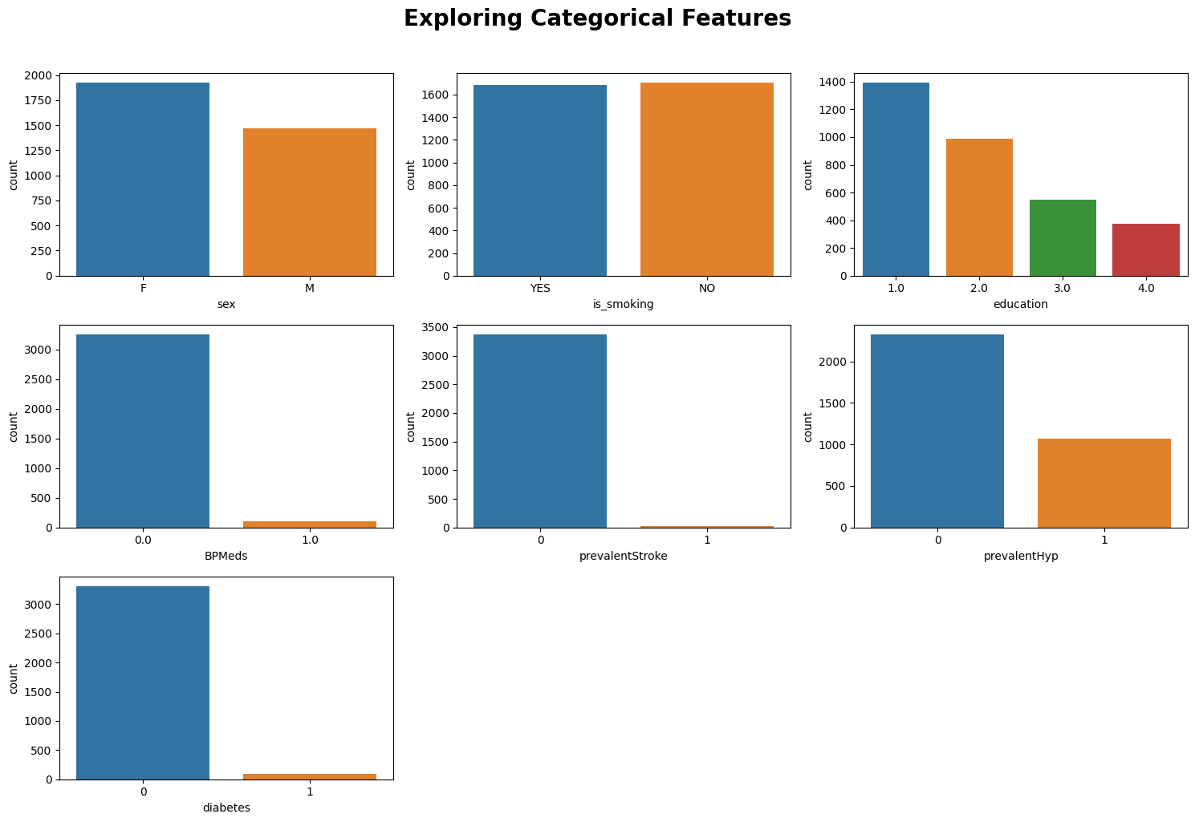
Exploratory Data analysis
Univariate analysis of Categorical Variables
Slightly more females than males in the dataset.
Non-smokers slightly outnumber smokers (around 1600 each).
Approximately 1500 individuals with education level 1, 400 with level 4.
Over 3000 individuals not taking medication for blood pressure.
Few people in the dataset have a history of stroke.
Around 1000 individuals identified as hypertensive.
More than 3000 people do not have diabetes.

Slide 6
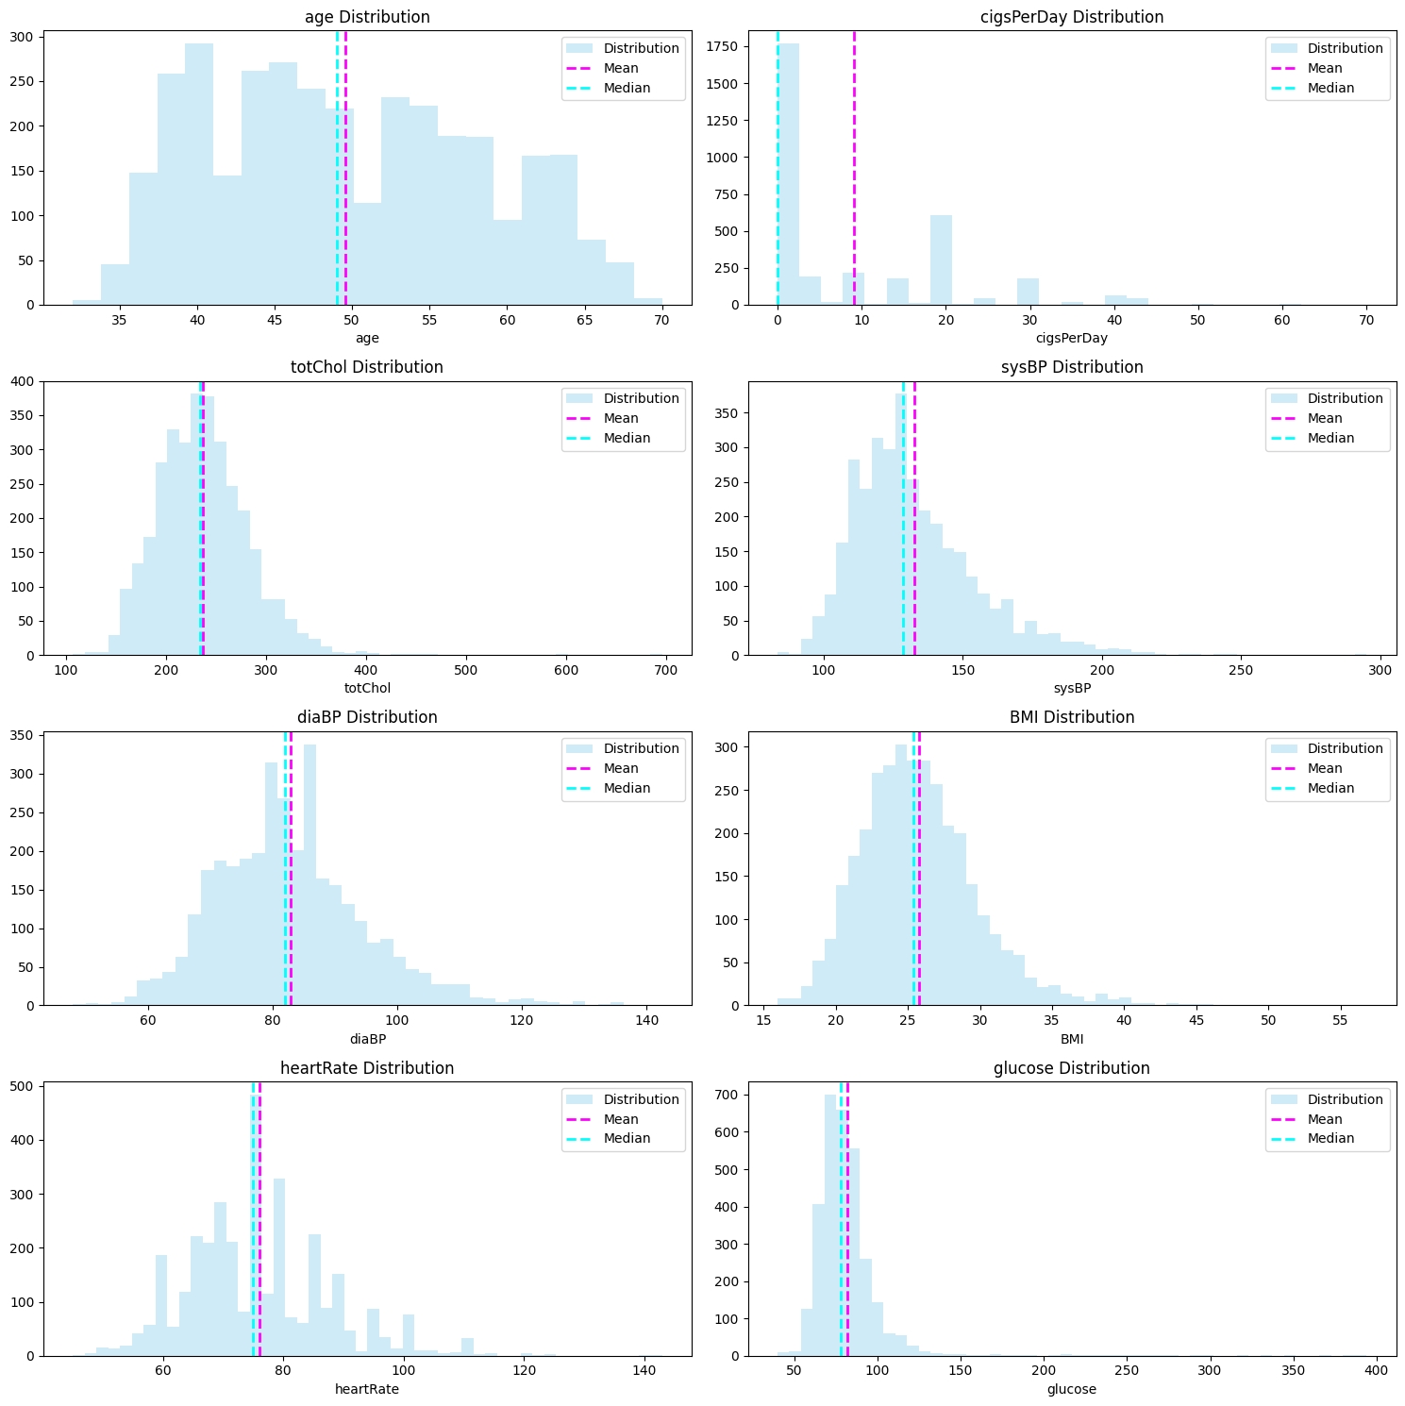
Univariate analysis of Numerical Variables
Age ranges from 35 to 70 years with a peak around 40 years.
Most individuals do not smoke, but some smoke 20 cigarettes per day.
Cholesterol levels range from 100 to 700, with the majority between 150 and 350.
Systolic Blood Pressure (BP) mainly ranges from 100 to 200.
Diastolic Blood Pressure (BP) mainly ranges from 60 to 120.
BMI varies from 16 to 40, reflecting a range of body weights.
Heart rate observed between 40 to 110 beats per minute, common around 75 BPM.
Glucose levels vary from 50 to 125, with some extreme values posing a risk of heart disease.

Slide 7
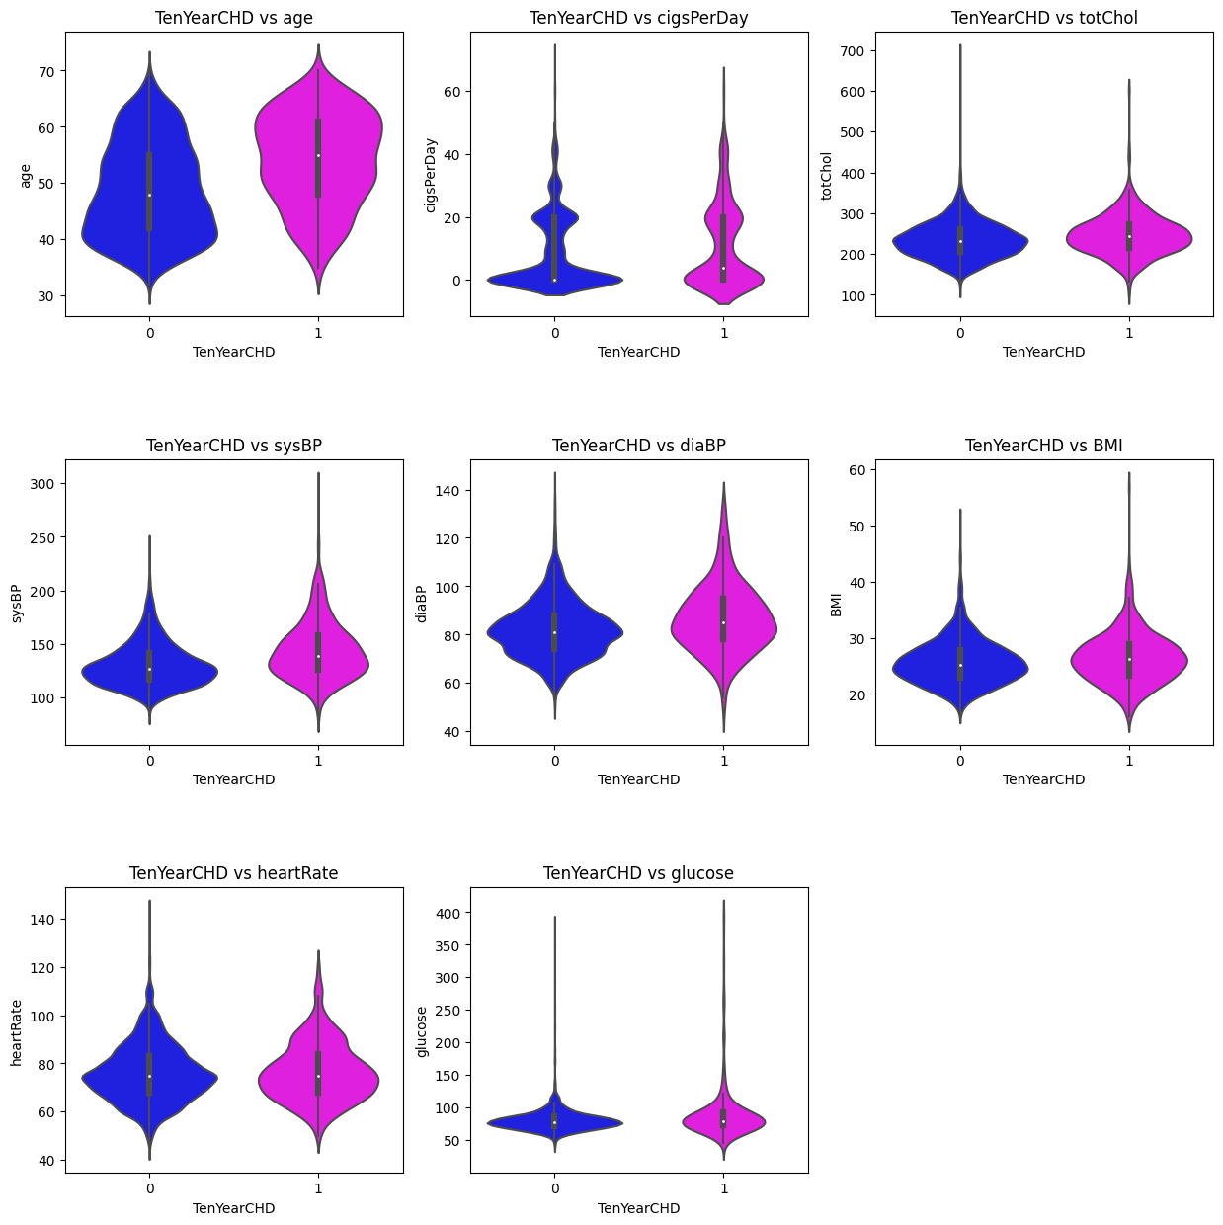
Bivariate analysis between the dependent variable and continuous independent variables
Higher CHD risk observed among older patients.
No conclusive evidence for other continuous variables' association with CHD risk.
Age identified as a significant risk factor, aligning with medical knowledge.
Further research needed to explore potential relationships with other variables.
Understanding CHD risk crucial for public health initiatives and patient care.
Additional investigations can provide valuable insights for preventive measures.
Comprehensive data analysis plays a vital role in advancing cardiovascular disease knowledge.

Slide 8
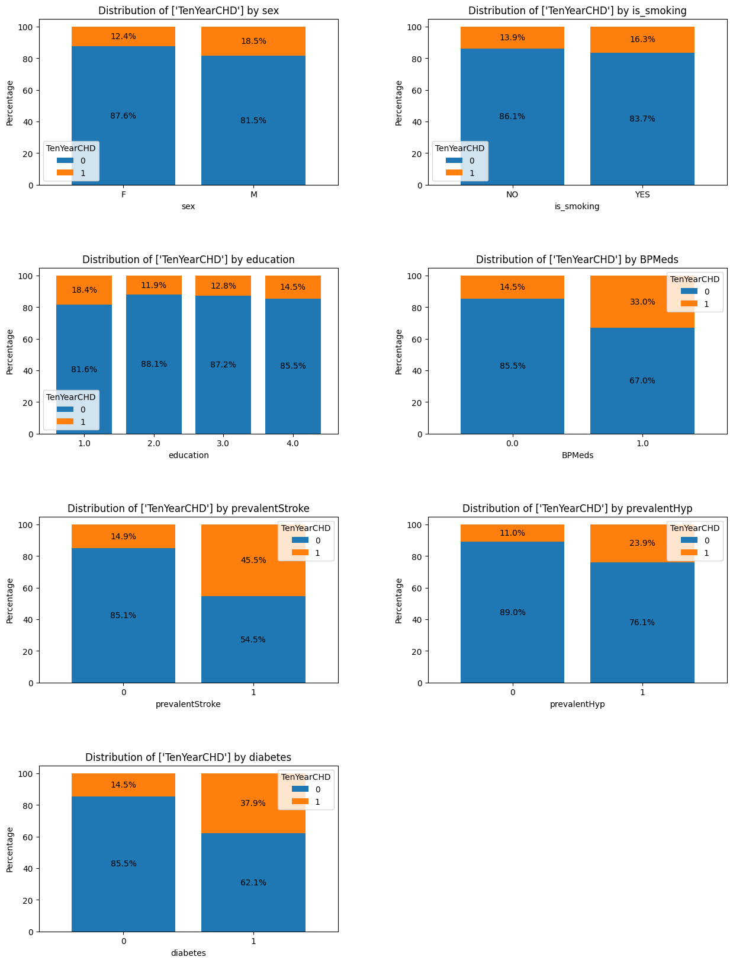
Bivariate analysis between the dependent variable and categorical independent variables
Male patients have an 18% CHD risk, while female patients have a 12% risk.
Smoking is associated with a 16% CHD risk, compared to 13% for non-smokers.
CHD risk percentages for education levels 1, 2, 3, and 4 are 18%, 11%, 12%, and 14%, respectively.
Patients on BP medication face a 33% CHD risk, compared to 14% for those not on medication.
Patients with a history of stroke have a 45% CHD risk, higher than the 14% risk for others.
Hypertensive patients face a 23% CHD risk, compared to 11% for non-hypertensive patients.
Diabetic patients have a 37% CHD risk, higher than the 14% risk for non-diabetic patients.

Slide 9
Feature Engineering & Data Pre-processing
Dataset Size: The dataset contains 3390 rows and 17 columns of person-specific medical data, essential for accurate predictions.
Null Values Handling: Two-step approach - drop rows with <5% nulls and impute the remaining rows to ensure data integrity and minimize risks.
Outlier Treatment: Interquartile Range (IQR) method used for identifying and handling outliers, enhancing data accuracy and analysis reliability.
Categorical Encoding: Performed one-hot encoding on the 'education' feature, converting it into binary columns for each unique category.
Feature Manipulation: Calculated 'pulse_pressure' by subtracting 'diaBP' from 'sysBP' and dropped the original 'sysBP' and 'diaBP' columns.
Feature Selection: Selected relevant features to improve model performance and reduce complexity.
Data Transformation: Applied log transformation on continuous variables, reducing skewness and enhancing data distribution.
Data Splitting: Split the dataset into training and testing subsets for model training and evaluation.
Handling Imbalanced Dataset: Used SMOTE (Synthetic Minority Over-sampling Technique) to balance the target class distribution.
Data Scaling: Applied StandardScaler to standardize feature values, preventing potential issues from varying scales.

Slide 10
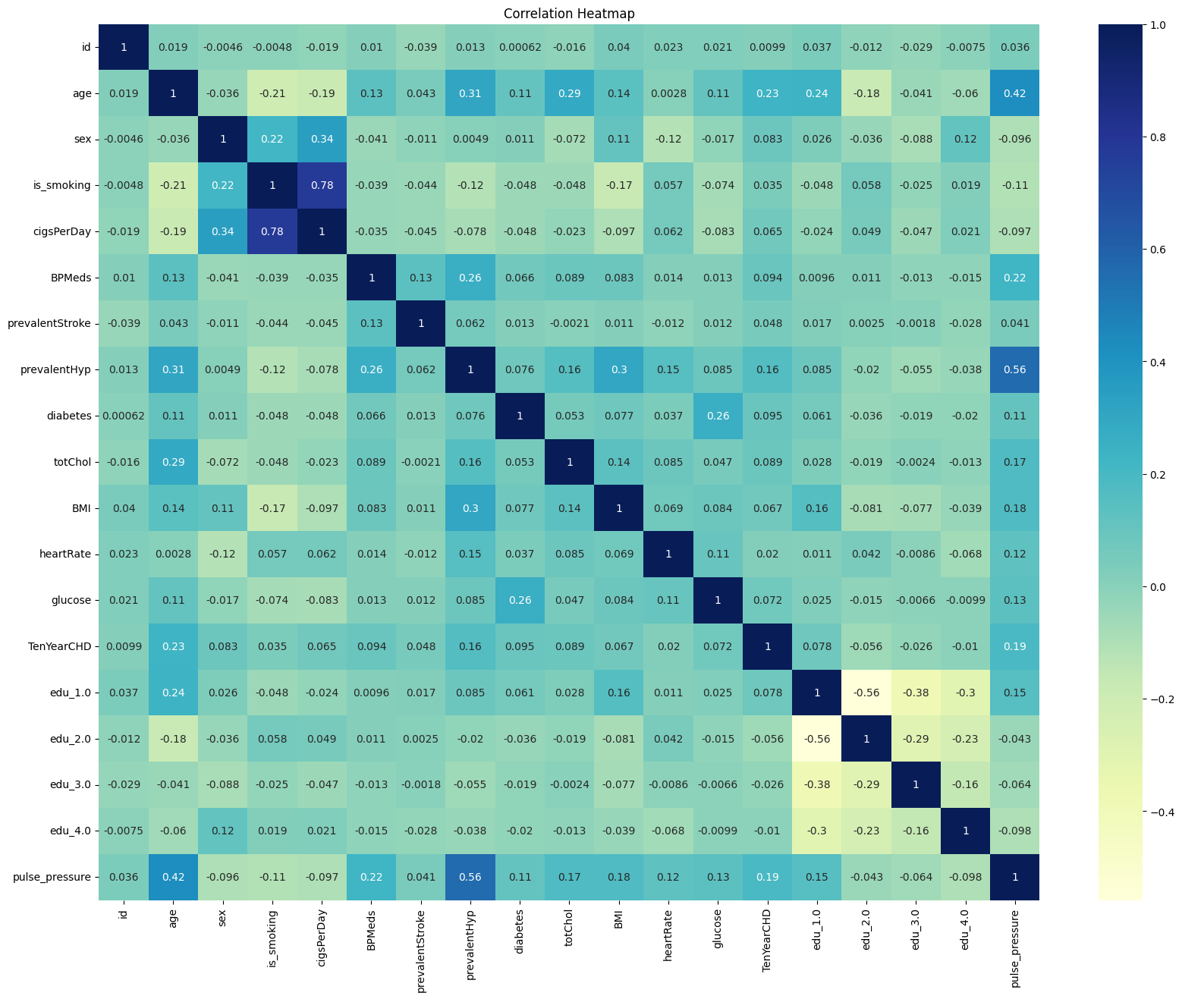
Correlation Heatmap
Age has positive correlations with hypertension and cholesterol levels.
Cigarettes smoked per day negatively correlates with BMI.
Hypertension has a positive correlation with pulse pressure.
Pulse pressure increases with age.
TenYearCHD (CHD risk) has weak positive correlations with age and hypertension prevalence.

Slide 11
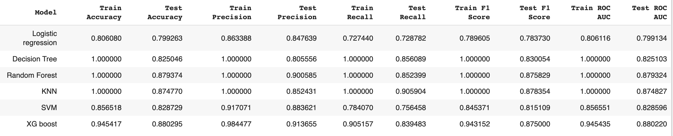
Evaluation metrics after model building
Logistic Regression: Stable performance, high accuracy, precision, recall, and F1 scores. Generalizes well.
Decision Tree: Some overfitting, good predictive power.
Random Forest: Overfitting, but robust performance with high accuracy and precision.
K-Nearest Neighbors (KNN): Overfitting, promising performance on test dataset.
Support Vector Machine (SVM): Stable performance, consistent accuracy, precision, recall, and F1 scores.
XGBoost: Excellent performance, high accuracy, precision, strong generalization.

Slide 12
Model selection
XGBoost is the preferred model for this task due to:
Highest Test Accuracy (88.03%): Ensures accurate predictions on unseen data.
High Precision (91.37%): Low false positive rate, minimizing misclassifications.
Balanced Performance: Good recall (83.95%) and F1 score (87.50%) for effective identification.
Minimal Overfitting: Strong generalization with close train and test metrics.
High ROC AUC (88.02%): Strong ability to discriminate between cases.

Slide 13
Conclusion
Developed XGBoost model predicts CHD risk using demographic, behavioral, and medical data.
High accuracy, precision, recall, F1 score, and ROC AUC demonstrated on both datasets.
Model identifies high-risk patients for tailored interventions.
Contributes to cardiovascular disease knowledge.
Potential for future research with additional features and longitudinal data.

Slide 14
Thankyou

